Slide 1
Submissions 1: Quick Quotes
5 April 2011
Notes:
Submissions 1: Quick Quotes - <number>
Guidewire training materials contain Guidewire proprietary information that is subject to confidentiality and non-disclosure agreements. You agree to use the information in this manual solely for the purpose of training to implement Guidewire software solutions. You also agree not to disclose the information in this manual to third parties or copy this manual without prior written consent from Guidewire. Guidewire training may be given only by Guidewire employees or certified Guidewire partners under the appropriate agreement with Guidewire.

Slide 2
Lesson objectives
By the end of this lesson, you should be able to:
  Describe the broad steps of submissions
  Describe the functionality of the Submission Manager
  Create and compare quick quotes
  This lesson uses the notes section for additional explanation and information.
  To view the notes in PowerPoint, choose View→Normal or View→Notes Page.
  If you choose to print the notes for the lesson, be sure to select “Print hidden slides.”
Notes:
Submissions 1: Quick Quotes - <number>

Slide 3
Lesson outline
Submission job basics
Submission Manager
Collecting quick quote information
Get a quote
Creating multiple versions Side-by-Side
Notes:
Submissions 1: Quick Quotes - <number>

Slide 4

Submissions
submission
policy term
Potentially creates a policy
  Qualifies candidate
  Involves one or more quotes
  Can bind and issue policy when acceptable quote is found
This lesson details submissions in base application
  Process and screens varies for each carrier
  Process and screens are fully configurable
Notes:
Submissions 1: Quick Quotes - <number>
All transactions (including submissions) have an written date and an effective date. Written date is the date the transaction was initiated. The effective date is the date that the transaction becomes effective. For example, you could create and complete a submission today for an auto policy that will not take effect until Monday of next week. Today would be the written date, but Monday of next week is the effective date.

Slide 5

Broad steps of a submission
Identify the product
Gather policy information
  What is to be covered?
  What are the coverages?
Get quote
  Can be done multiple times to find quote that is agreeable
Bind and issue the policy
  Bind – contract is legally binding
  Issue – policy is printed
Policy
Notes:
Submissions 1: Quick Quotes - <number>
A submission job can be broken down into four basic steps.
First, for a given producer and account, the underwriter must identify what product the applicant is interested in. The combination of account and producer may render some products unavailable. (This is discussed in greater detail later in this lesson.)
Next, the underwriter identifies the specifics of the policy. The bulk of this information is about what is to be covered (the business, locations, buildings, vehicles, classes of workers, and so on) and what coverages are to be obtained.
After that, the underwriter gets a quote for the policy. There are two ways this can be done: a quick quote (which requires less information but produces a quote which is not bindable) and a full application (which requires more information but produces a bindable quote). Quick quotes are useful for determining if the policy can be priced at an amount that's in the range of what the customer or potential insured wants. They are optional. Full applications are required.
Finally, if an acceptable full application quote can be arrived at, the policy is bound and issued. At that point, it becomes a legal agreement between insured and carrier.

Slide 6

Types of quotes
A "quick quote" is used to rapidly assess whether policy can be offered with acceptable premium
  Based on minimal information
  Cannot be used when policy is bound
A "full application" quote can be used to make policy legally binding contract
  Based on complete information
  Used when policy is bound
Notes:
Submissions 1: Quick Quotes - <number>
A quick quote is a quote which is designed to rapidly assess whether a policy can be offered for a premium that is roughly suitable for the applicant. Quick quotes can be done only for draft submissions which have not entered the full application process. Quick quotes are based on minimal information.
A bindable quote is a quote which can be used to bind the policy and make it a legal contract. Bindable quotes can be done only for full application submissions. Bindable quotes are based on a complete set of policy information.
Quick quotes are in fact estimated quotes. If you create a quick quote and a full application quote using exactly the same data, you should get the same value for the quote. However, in most cases, the full application quote is not the same as the quick quote because the full application process collects information not asked for in the quick quote process, and this information can change the quote.
In the base application, a quote never expires. You could add functionality to the application so that quotes did expire. (For example, you could prevent the binding of a submission and require re-quoting if the date the quote was generated is more than X number of days in the past.) However, this would require some minor configuration.

Slide 7
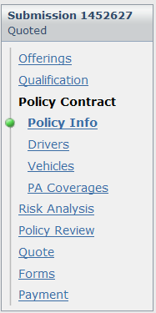
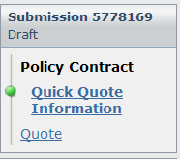
Quick Quote (QQ)
Quick Quote feature provides fast new submission quote estimates to insured
Full App wizard
QQ wizard
Notes:
Quick quotes collect an abbreviated data set with relaxed validation. If the insured decides to pursue the quote, the quote is then converted to a full application where additional data is collected and full validation is executed.
Note: In the base configuration, the Personal Auto line of business is configured to have a shorter quick quote as shown above. Other LOBs in the base application are not configured for this shorter quick quote. Configuration users can configure other LOBs to have this quick quote framework by modifying the PCFs looking at the PA line of business as an example.
Submissions 1: Quick Quotes - <number>

Slide 8
Possible outcomes of a PC submission
Policy is issued
Submission is closed
  Withdraw - submission abandoned
  Decline - carrier chooses not to offer
  Not taken - account chooses not to accept
  Expires – sufficient time has elapsed but the policy is not bound or issued
Policy request is sent to an external system for further processing
Notes:
Submissions 1: Quick Quotes - <number>
Withdraw: A submission can be withdrawn for any reason, such as mistakes were made on the policy. You can only withdraw a submission in Draft or Quoted status. The withdrawn submission, and all its versions becomes uneditable.
Decline: An underwriter may decide to decline a submission, and if so, must provide a reason using a Reason Code. A submission may be declined for reasons including loss history, payment history, or requested coverages and/or limits not available. The declined submission is uneditable.
Not Taken: Select this option when the applicant decides not to take the offered policy. You must enter a reason. You can also enter text to create a Not Taken letter. You can select this option from both the submission wizard and the Submission Manager. Generate the Not Taken letter from the Submission Manager.
Expires: A submission is expired after a sufficient and configurable interval of time has elapsed. A policy version can be expired when its status is either New, Draft, or Quoted. When a policy version expires, its status changes to Expired. You can view the status in the Submission Manager screen or in the toolbar if you are in the submission job wizard. An expired branch is not editable.

Slide 9
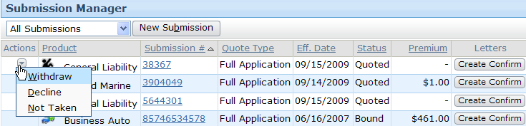
Submission Manager
Appears for incomplete submissions only
Submission Manager is account-level screen used to create and manage submissions for given account
  For each submission, list notes:
    Product, Submission #, Premium and Effective date
    Quote type (quick quote or full application)
    Status (including bound, issued, withdrawn, declined, not taken)
    Create letters through Create Confirm button
    Action menu to withdraw, decline or not take a policy
Notes:
Submissions 1: Quick Quotes - <number>
The Submission Manager screen contains summary information such as line of business, quote type, effective date, status of the transaction, and the premium. You can use this screen to do actions, such as withdrawing a submission. Use the Submission Manager is to view multiple submissions on an account and view the aggregate premium of all policies on the account. You can view using the following filters: All, Open, and Complete. All is the default. If you select Open, then the screen displays only submissions that have at least one version in an open status. If you select Complete, then the screen displays only submissions with no open versions.

Slide 10
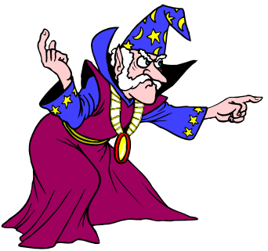
Submission wizard
Quick Quote Information
Quote
modify quote
Qualifi-
cation
Policy
Info
Risk
Analys.
Policy
Review
Full App.
Quote
Coverages
Modifiers
Bind and
Issue
Forms
Payment
Notes:
Submissions 1: Quick Quotes - <number>
The submission wizard governs the manner in which information about the submission job is gathered and displayed in the user interface. The wizard can be broken down into three main areas:
Quick quote gathers the minimal information needed to generate a quote.
Full application gathers the complete set of information needed to apply for a bindable quote.
Binding/Issuing Policy, which are the screens in which the policy gets bound and issued.
The diagram above is a rough description of the route through the Submission Wizard, but it is not absolute. For example, a quick quote can be converted to a full application quote at any time, not just from the Quote screen. Also, an underwriter can navigate back and forth between steps. For example, an underwriter could go to Policy Info, and then to one of the Coverages screen, and then back to Policy Info.
The steps to collect policy information and generate quote are captured in both the Quick Quotes section of the submission wizard AND the Full Application section of the submission wizard.
What is the Advantage of Using Quick Quote?
Select Quick Quote if you need to generate a quote with minimal information. Quick quote provides a rapid assessment of whether or not the carrier can provide a policy premium that is in the applicant’s price range. If both parties are agreeable to the quote, then additional information must be gathered in a Full Application before it can be bound. You can generate as many quick quotes as you need, compare them as different versions or get a side-by-side quote and save them, but you cannot bind them. From Quick Quote, you can continue to Full Application.

Slide 11
Submission wizard
Quick quotes (this lesson)
Quick Quote Information
Quote
modify quote
Qualifi-
cation
Policy
Info
Risk
Analys.
Policy
Review
Full App.
Quote
Coverages
Modifiers
Full
applications
(next lesson)
Bind and
Issue
Forms
Payment
Notes:
Submissions 1: Quick Quotes - <number>
In this training, the Submission: Quick Quotes lesson discusses generating quick quote using the Personal Auto LOB as an example.

Slide 12
Lesson outline
Submission job basics
Submission Manager
Collecting quick quote information
Get a quote
Creating multiple versions Side-by-Side
Notes:
Submissions 1: Quick Quotes - <number>

Slide 13
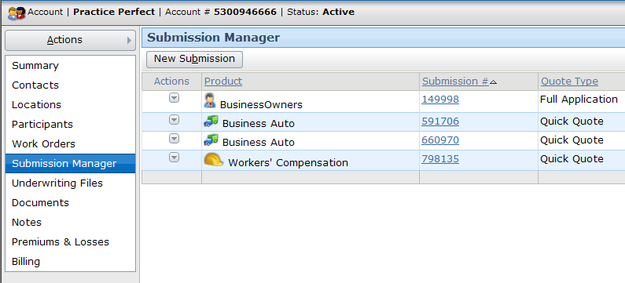
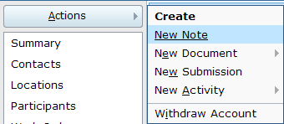
Starting submissions
From Submission Manager
From Accounts Actions menu
Notes:
Submissions 1: Quick Quotes - <number>
The New Submission menu item in the Policy tab menu simply has the user identify a producer and an account and then routes the user to the Submission Manager for that account.

Slide 14
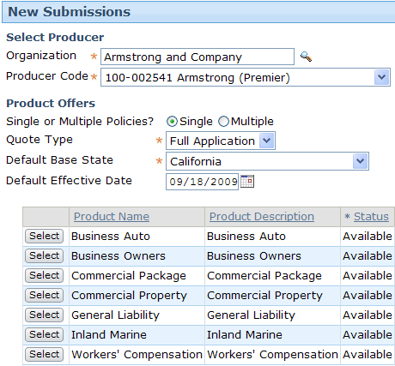
New submission screen
1. Verify producer
2. Select quote type
3. Modify effective date
4. Select product
(which initiates wizard)
Notes:
Submissions 1: Quick Quotes - <number>
New Submission screen steps:
When you create an account, you must specify a default producer. This is the producer that appears at the top of the New Submission(s) screen. However, it can be changed prior to creating the submission.
The quote type must be either "Quick Quote" or "Full Application".
The default effective date is typically the date the submission is created, though it can be modified.
The "Select" buttons in the product list, are visible to select the product for which the submission is created.

Slide 15
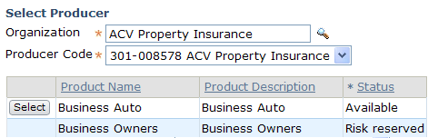
Product offering statuses
Risk reserved
  Policy of that product type already issued for that account via different producer
Available
  Policy of that type can be created
Notes:
Submissions 1: Quick Quotes - <number>
In some cases, a carrier makes an agreement with a producer such that it will only offer a given product to a given account through that producer. This is called "risk reservation". (For example, Acme Insurance may have agreed to sell BusinessOwners Policies to Demo Deliveries only through Armstrong and Company. Since the current submission specified Demo Deliveries but did not specify Armstrong and Company, the BusinessOwners product is not available.)
A product can be applicable to companies only, persons only, or both.

Slide 16
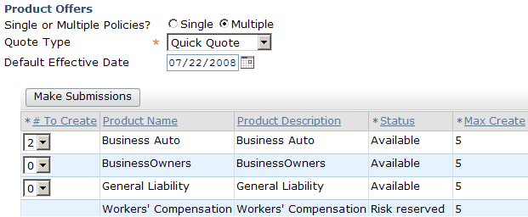
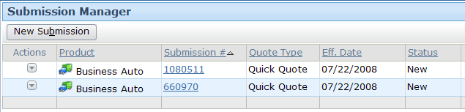
Multiple submissions
Notes:
Submissions 1: Quick Quotes - <number>
The "Multiple" policies option is a rapid way to create multiple submission jobs. When you select "Multiple" policies, each Select button is replaced with a dropdown. From the dropdown, you can select any number from 0 to the "Max Create" value for that product. Then, when you click Make Submissions, PolicyCenter creates the desired submissions. The user must still execute each submission job manually.

Slide 17
Lesson outline
Submission job basics
Submission Manager
Collecting quick quote information
Get a quote
Creating multiple versions Side-by-Side
Notes:
Submissions 1: Quick Quotes - <number>

Slide 18
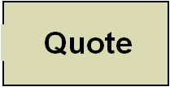
Submission wizard
Quick quotes (this lesson)
Quick Quote Information
modify quote
Qualifi-
cation
Policy
Info
Risk
Analys.
Policy
Review
Full App.
Quote
Coverages
Modifiers
Full
applications
(next lesson)
Bind and
Issue
Forms
Payment
Notes:
Submissions 1: Quick Quotes - <number>
In this training, the Submission: Quick Quotes lesson discusses generating quick quote using the Personal Auto LOB as an example.

Slide 19
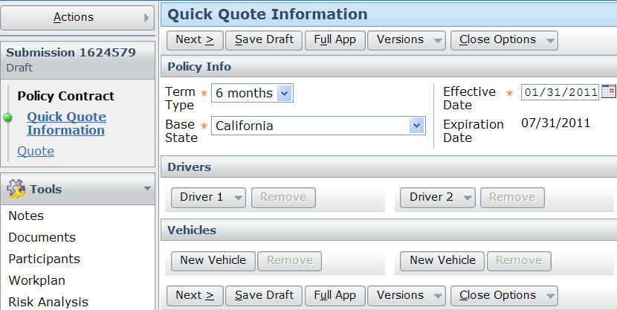
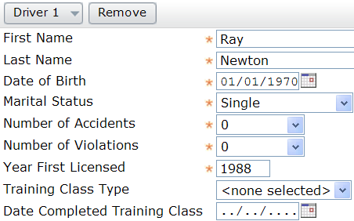
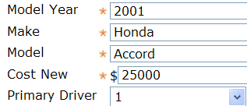
Quick Quote – Info page
Notes:
This page was designed for quick entry of minimum info to quote a PA policy for at most 2 drivers and 2 vehicles. This should handle most quick quote scenarios. Typically, a policy with more than 2 drivers and/or more than 2 vehicles is complex enough that a full app quote would be required to give a more accurate premium estimate. If a carrier wants to extend quick quote functionality for policies with more than 2 drivers or vehicles, a configuration user can modify the related PCFs and enhancements.
Submissions 1: Quick Quotes - <number>

Slide 20
Offerings
Insurers need variations of policies depending on
buyer
An Offering lets insurers define different product types based on existing product definitions
1
2
3
Carrier
BOP
Product
Policy
Set of Offerings
Notes:
Submissions 1: Quick Quotes - <number>
Sometimes carriers have large numbers of variations around a few base products. Insurers want to be able to create these offerings quickly, often based on a similar pre-existing product. PolicyCenter provides the tools to quickly and easily create offerings based on an existing product definition. You start with the base product definition, and then simply tailor it to define your specific offering. The offerings would also allow customers to modify default values for coverages, coverage terms, etc. Offerings are discussed in detail in Product Model section later in this course.

Slide 21
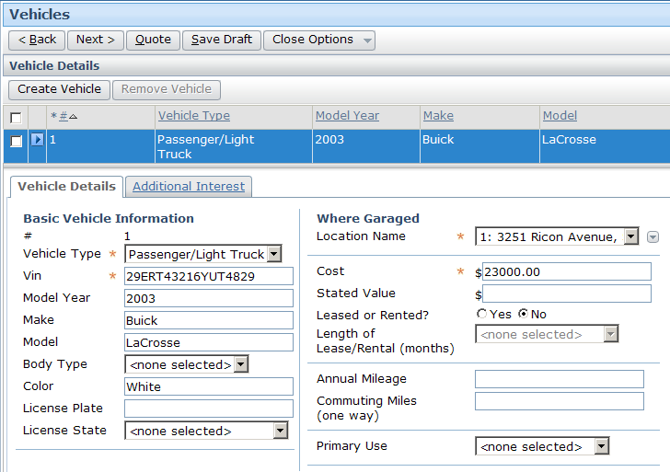
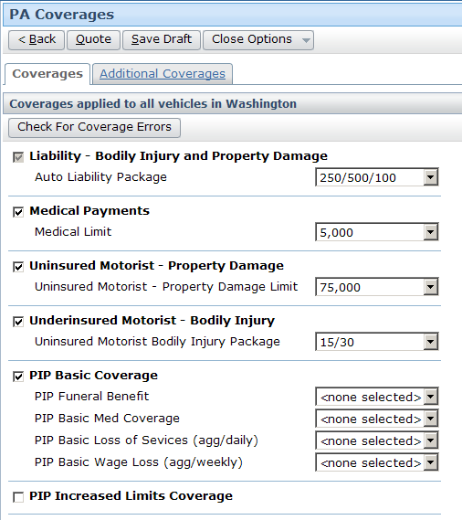
Coverage example: Personal auto
Coverage functionality discussed in detail in Product Model section
Notes:
Submissions 1: Quick Quotes - <number>
Each LOB has different types of coverages, covterms, and modifiers.

Slide 22
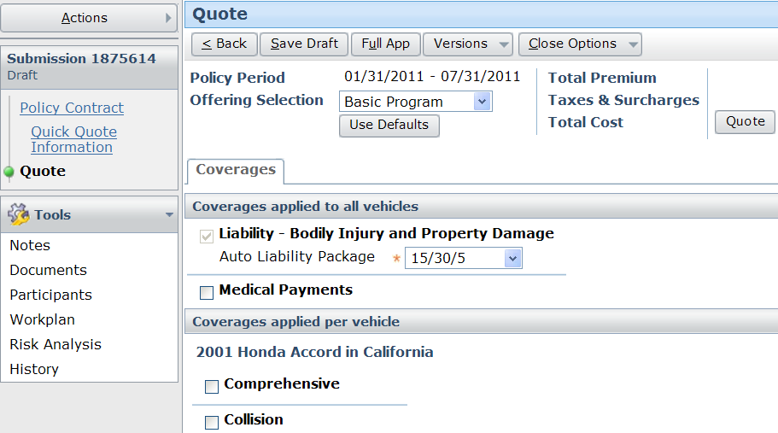
Add offerings, coverages, covterms, and so on
Notes:
On entry into the page, a default offering is selected and applied. The user can manually adjust coverages and covterms or choose a different offering to apply before clicking on Quote to generate a quote. Carriers will likely want to set the default offering according to their own preferred offering.
Submissions 1: Quick Quotes - <number>

Slide 23
Lesson outline
Submission job basics
Submission Manager
Collecting Quick Quote information
Getting a quote
Creating multiple versions Side-by-Side
Notes:
Submissions 1: Quick Quotes - <number>

Slide 24


Quick quotes
modify quote
Qualifi-
cation
Policy
Info
Risk
Analys.
Policy
Review
Full App.
Quote
Coverages
Modifiers
Bind and
Issue
Forms
Payment
Notes:
Submissions 1: Quick Quotes - <number>

Slide 25
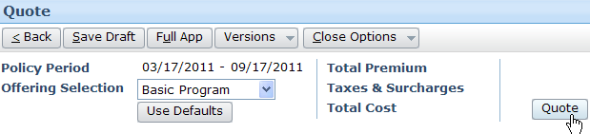
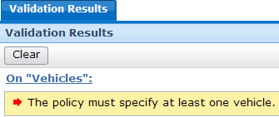
Quoting a submission
Quote button is visible and available in the Quote step
When clicked:
  Validation rules verify submission is quotable
  Rating engine is queried for quote
  Appropriate error messages and warnings are displayed
Notes:
Submissions 1: Quick Quotes - <number>
Even though the Quote button is visible from the beginning of the wizard, if valid information is not entered for coverable and coverage on the policy, appropriate error message or warnings are displayed. Then user can generate quick quotes. The only way to navigate to the "Quote" step is by clicking the "Quote" button

Slide 26
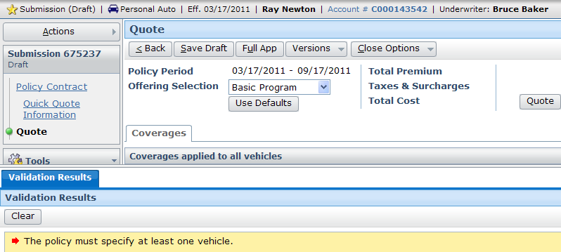
Validating submission is quotable
Notes:
Submissions 1: Quick Quotes - <number>
When the Quote button is clicked, validation verifies that the submission is quotable. For example, validation might verify that every policy has at least one vehicle.

Slide 27


Source of quotes
collision (deductible: $500)
premium: $1055
In base application, quotes are supplied by series of entity enhancements (functions)
collision (deductible: $500)
Rating
Engine
premium: $1055
In a production environment, quotes are supplied by internal or external rating engine
Notes:
Submissions 1: Quick Quotes - <number>
Customers can use PolicyCenter’s internal rating engine using the Extension Pack called Rate Table Maintenance. For more information on this refer to the extension’s documentation. Integration to an external rating engine is beyond the scope of this course.

Slide 28
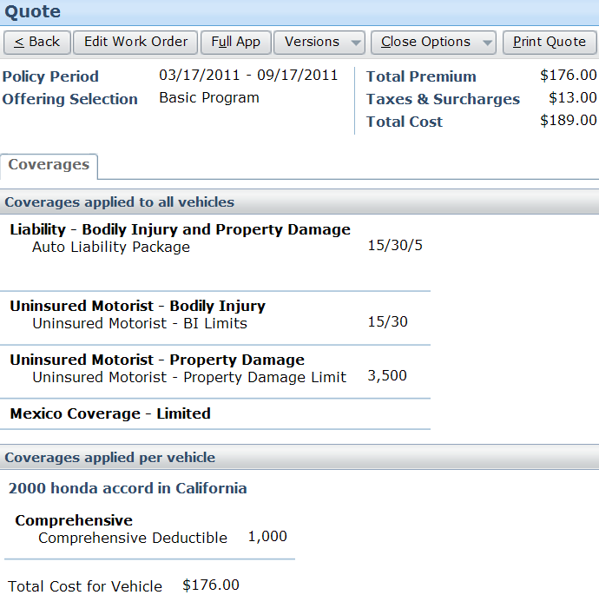
Quote details
Notes:
To generate the first quote, the user simply clicks the "Quote" button.
Quotes are generated by taking the information supplied (coverables, coverages, and coverage terms) and sending it to a rating engine. The rating engine uses the information to calculate what the premium will be. In some cases, the calculation can be complex (such as when the calculation involves an uninsured motorist coverage which may have a premium that varies based on number of cars in the fleet, deductible, zip code of the garage, requirements of the state in which the car is garaged, type of vehicles, vehicle usage, accident history of the drivers involved, and so on.)
The quote is broken down into smaller line items.
Submissions 1: Quick Quotes - <number>

Slide 29
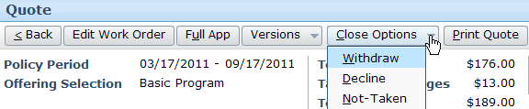
After first quick quote
Convert to Full App
Close the submission
Edit and requote a submission
Create and edit versions of Side-by-Side data during submission
Notes:
Submissions 1: Quick Quotes - <number>
The Edit Work Order button is provided through which the user has the option to edit a work order after it is quoted in case they want to change coverages, driver, or vehicle information after getting a quote. They will have to re-quote the submission.
To edit submissions, user must have the viewsubmission and editsubmission system permissions.
If a user agrees with the quote they can go to Full App to bind and issue the policy. User can convert to Full App to continue with the submission flow by clicking on the Full App button. Users will have to enter additional info at that time to complete the submission.

Slide 30
Lesson outline
Submission job basics
Submission Manager
Collecting Quick Quote information
Getting a quote
Creating multiple versions Side-by-Side
Notes:
Submissions 1: Quick Quotes - <number>

Slide 31
Multiple quick quotes
collision
deductible: $500
collision
deductible: $1000
collision
deductible: $3000
Underwriter can create multiple versions of submission and generate quick quotes for each version
  Gives ability to compare financial impact of different choices
Notes:
Submissions 1: Quick Quotes - <number>
Whenever there are multiple versions of a submission, there is always only one selected version. If you decided to convert a quick quote to a full application, all versions are converted.

Slide 32
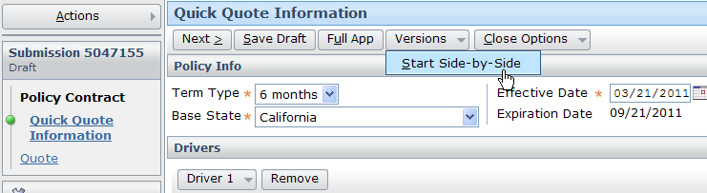
Getting multiple quote for comparison
Start Side-by-Side quoting for comparison
Notes:
Click on Versions > Start Side-by-Side to create multiple quotes using the Side-by-Side feature. The Side-by-Side feature is discussed in detail in the Side-by-Side Quoting lesson.
Submissions 1: Quick Quotes - <number>

Slide 33
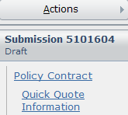
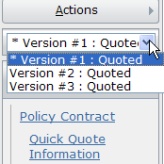
Multiple versions of submission
Vers. 1
Vers. 2
Vers. 3
Multiple version
drop-down appears
Notes:
Submissions 1: Quick Quotes - <number>
Whenever there are two or more versions of a submission draft, a “Version Selector" dropdown appears in the navigation panel.
If there is only one version of a submission draft, the Version Selector dropdown is hidden.
This limit on number of versions can be configured to any number, but usability constraints (such as the heavy amount of scrolling that would be involved with four or more versions of a policy in the policy versions screen) should be kept in mind.

Slide 34


Adding a new version
Vers. 1
Vers. 2
Vers. 3
Vers. 4
New version created
in Draft mode
Notes:
When you click “Add Side-by-Side Version", a copy of the currently selected version is created in the Draft mode. You can make modifications to that copy (without affecting the original) and then generate a quote for the copy. This is an easy way to let applicants explore "what if" scenarios to see how changes to coverages will affect the policy premium. The versions are numbered as Version #1, Version #2, Version #3, and so on, but users can give a meaningful name.
Submissions 1: Quick Quotes - <number>

Slide 35

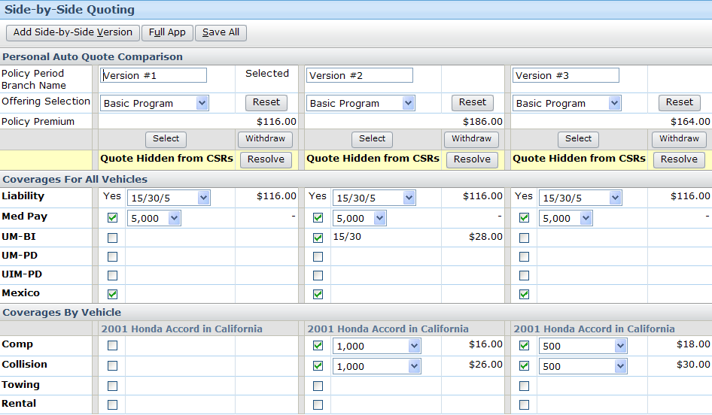
View all versions Side-by-Side
Side-by-side columns of different versions
Notes:
The selected version says “Selected” next to the version name. Users can add more versions at any time by clicking the Add Side-by-Side Version.
Submissions 1: Quick Quotes - <number>

Slide 36
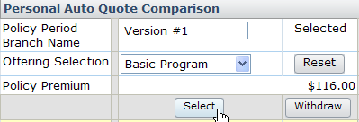

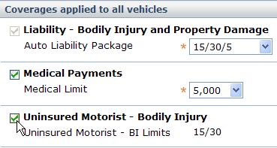
Editing Side-by-Side data
Side-by-side data change applies to selected version only
1.
2.
3. Make change as you would in QQ Job wizard
Notes:
Users can edit the QQ wizard pages of Quick Quote Information or Quote and add or remove drivers, vehicles, coverages, covterms, and so on. All of these are discussed in lessons later in this course.
Submissions 1: Quick Quotes - <number>

Slide 37

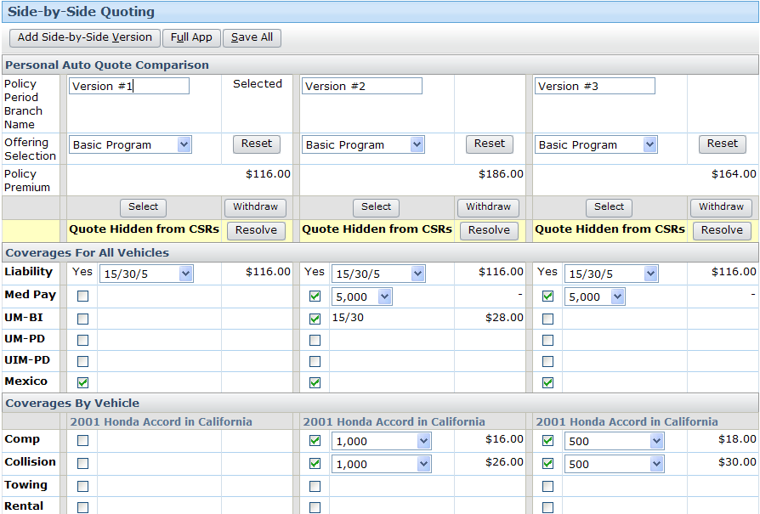
Quoting all versions Side-by-Side
Notes:
You can also use Tools > Side-by-Side Quoting page to see the changes and quote or re-quote at any time. Note that the Add Side-by-Side Version button appears on the Side-by-Side Quoting page which can be used to add more versions for comparison from this page.
Submissions 1: Quick Quotes - <number>

Slide 38
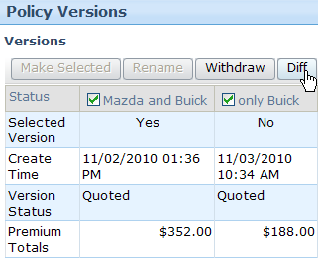
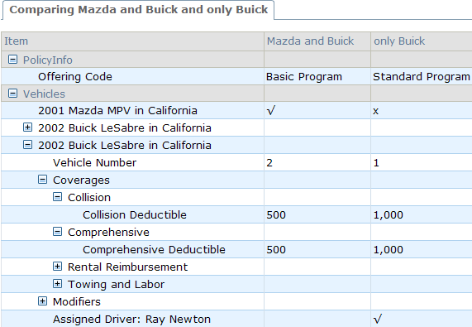
Viewing diffs for Side-by-Side versions
Displays diffs in a tree view
Notes:
On the Policy Version page select the versions you want to diff. Click on the Diff button. This displays a tree view of all the selections on all objects on the submission.
Submissions 1: Quick Quotes - <number>

Slide 39
Lesson objectives review
You should now be able to:
  Describe the broad steps of submissions
  Describe the functionality of the Submission Manager
  Create and compare quick quotes
Notes:
Submissions 1: Quick Quotes - <number>

Slide 40
Review questions
What are the three possible outcomes of a submission?
What is the difference between a quick quote and a full application quote?
If the Quote button is visible, can you quote the submission?
For a quoted submission, what is the difference between the "Edit Work Order" button and the “Add Side-by-Side Version" button?
Notes:
Submissions 1: Quick Quotes - <number>
Answers
1. A policy is created, no policy is created, a policy request is sent to an external system.
2. A quick quote is based on a small amount of information but cannot be used to bind a policy. A full application quote is based on a larger amount of information and can be used to bind a policy.
3. Not necessarily. When the quote button is clicked, the policy is validated to check if it is quotable. If it isn't (say, for example, it is a personal auto policy with no vehicles specified), then the quote is not generated.
4. The Edit Work Order button allows you to modify the existing version of the submission. The Add Side-by-Side Version button creates a new copy of the selected version of submission which you can modify without altering the original version.

Slide 41
Notices
Copyright © 2001-2011 Guidewire Software, Inc. All Rights Reserved.
Guidewire, Guidewire Software, Guidewire ClaimCenter, Guidewire PolicyCenter, Guidewire BillingCenter, Guidewire Reinsurance Management, Guidewire ContactManager, Guidewire Vendor Data Management, Guidewire Client Data Management, Guidewire InsuranceSuite, Guidewire ContactCenter, Guidewire Studio, Gosu, Deliver Insurance Your Way, and the Guidewire logo are trademarks or registered trademarks of Guidewire Software, Inc. in the United States and/or other countries.
This material is Guidewire proprietary and confidential. The contents of this material, including product architecture details and APIs, are considered confidential and are fully protected by customer licensing confidentiality agreements and signed Non-Disclosure Agreements (NDAs).
This file and the contents herein are the property of Guidewire Software, Inc. Use of this course material is restricted to students officially registered in this specific Guidewire-instructed course, or for other use expressly authorized by Guidewire. Replication or distribution of this course material in electronic, paper, or other format is prohibited without express permission from Guidewire.
    Guidewire products are protected by one or more of the following patents: U.S. Patent No. 7,885,831; U.S. Patent No. 7,788,296.
Notes:
Introduction to Guidewire Configuration - <number>

